Slide 1




TESI DI LAUREA
in
Sistemi di Produzione di Beni e Servizi
Advanced Analytics in Maritime Transport: Fuel Consumption Forecasting via Synthetic Upsampling of Constant Schedule Data
Case Study: Grimaldi Group S.p.A.
RELATRICE
Ch.ma Prof.ssa Teresa Murino
CORRELATRICI
Ing. Luisa Montella
Ing. Monica Strazzullo
CANDIDATA
Vincenza Siani
M62003043

Slide 2
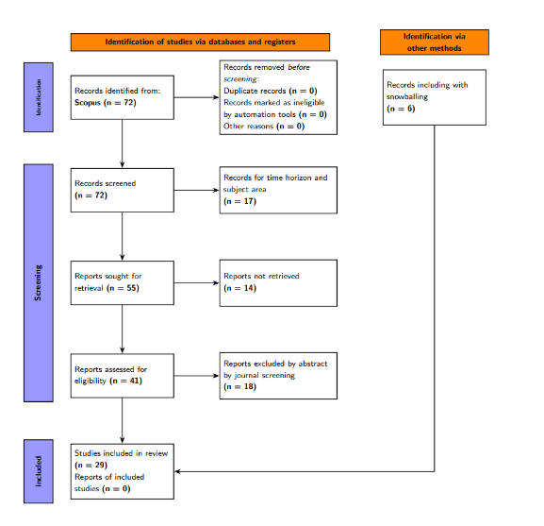

THE CONTEXT:
THE GLOBAL CHALLENGES
CANDIDATA
Vincenza Siani
M62003043
80% of global trade
3% of greenhouse
gas emissions
To overcome the challenges of this complex scenario, high-precision fuel consumption forecasting becomes a strategic priority

Slide 3
LITERATURE REVIEW
CANDIDATA
Vincenza Siani
M62003043
PRISMA analysis allows you to select and filter scientific articles

Slide 4

LITERATURE REVIEW
CANDIDATA
Vincenza Siani
M62003043
CONTEXT
INTERVENTION
– IMO targets and CII rating for maritime decarbonization
– Coexistence of manual Noon Reports and automated IoT telemetry
– Significant impact of metocean conditions on fuel consumption
-Interpretable classical ML algorithms (e.g., Regressions or simple Decision Trees)
-Advanced ML algorithms (XGBoost, Random Forest, SVM)
-Deep Learning architectures for time-series (ANN, LSTM, GRU)
C
I
O
M
OUTCOMES
MECHANISM
– Forecasting of fuel consumption and emissions
– Estimation of main engine shaft power
– Speed Optimization
– Hydrodynamic modeling of hull and added wave resistance
– Supervised learning of non-linear variable
– Capturing temporal dependencies and powertrain inertia

Slide 5

LITERATURE REVIEW
CANDIDATA
Vincenza Siani
M62003043
White Box
Black Box
-Mathematical formulas that are easy to understand
-Interpretability
-They are unable to capture non-linear relationships
-High accuracy
-Ideal for analysing time series
-Additional tools are required to interpret the results

Slide 6
PROBLEM STATEMENT
CANDIDATA
Vincenza Siani
M62003043
methodological and operational gaps
When planning a future trip the business decision-maker has access to static data:
data-driven models produce flat, unrealistic forecasts﻿
The present thesis proposes:
COMPARISON
OVERCOMING THE
STATIC CONSTRAINTS

Slide 7
PROBLEM STATEMENT
CANDIDATA
Vincenza Siani
M62003043
methodological and operational gaps
When planning a future trip the business decision-maker has access to static data:
data-driven models produce flat, unrealistic forecasts﻿
The present thesis proposes:
The Long Short-Term
memory neural network
Least Squares
Partial Least Squares
Regression
OVERCOMING THE
STATIC CONSTRAINTS

Slide 8
PROBLEM STATEMENT
CANDIDATA
Vincenza Siani
M62003043
methodological and operational gaps
When planning a future trip the business decision-maker has access to static data:
data-driven models produce flat, unrealistic forecasts﻿
The present thesis proposes:
Creating a Synthetic
Dataset
COMPARISON

Slide 9
METHODOLOGY
CANDIDATA
Vincenza Siani
M62003043
PHASE 1:
Data collection
Data Pre-processing and Cleaning
PHASE 2: TRAINING
LS-PLS regression
LSTM network
PHASE 3:
Creating the synthetic dataset
PHASE 4: VOYAGE PLANNING
LS-PLS regression
LSTM network

Slide 10

METHODOLOGY (1/4)
CANDIDATA
Vincenza Siani
M62003043
Pre-processing and Data cleaning:
The reliability of the data is important for ensuring an accurate forecast
Integrity of
Data
Status of the
ship
Anomaly

Slide 11
METHODOLOGY (1/4)
CANDIDATA
Vincenza Siani
M62003043
Pre-processing and Data cleaning:
The reliability of the data is important for ensuring an accurate forecast
Integrity of
Data
Status of the
ship
Anomaly
Character formatting
Duplicate management
Allocation of Missing Values

Slide 12
METHODOLOGY (1/4)
CANDIDATA
Vincenza Siani
M62003043
Pre-processing and Data cleaning:
The reliability of the data is important for ensuring an accurate forecast
Anomaly
Integrity of
Data
Status of the
ship
Removing abnormal
spikes

Slide 13
METHODOLOGY (1/4)
CANDIDATA
Vincenza Siani
M62003043
Pre-processing and Data cleaning:
The reliability of the data is important for ensuring an accurate forecast
Status of the
ship
Integrity of
Data
Anomaly
Isolation of the
operating state
of interest

Slide 14
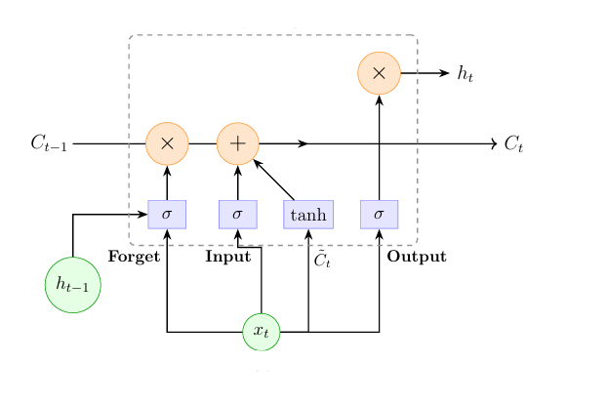


METHODOLOGY (2/4)
CANDIDATA
Vincenza Siani
M62003043
THE GOAL:
Fuel Consumption
The Long Short Term Memory (LSTM) neural network is suitable since it leverages an internal sequential memory (Ct)
INPUT GATE:
$$f_{t}=∂\left(W_{f}∗⟦h_{t−1},x_{t}⟧+b_{f}\right)$$
FORGET GATE:
$$i_{t}=∂\left(W_{i}∗⟦h_{t−1},x_{t}⟧+b_{i}\right)$$
OUTPUT GATE:
$$o_{t}=∂\left(W_{o}∗⟦h_{t−1},x_{t}⟧+b_{o}\right)$$
$W_{k}=Weights; b_{k}=Bias; h_{t−1}=Short−Term memory; x_{t}=Input vector; ∂=$Sigmoid Activation function

Slide 15
METHODOLOGY (2/4)
CANDIDATA
Vincenza Siani
M62003043
The selected variables fall into three categories:
navigation_vars = [SOG, STW, DRAFT AFT, DRAFT FOR, HEADING, MILES]
power_vars = [SHA POW 1, SHA POW 2,
SHG POW 1, SHG POW 2]
weather_vars = [WIND SPEED, WAVE HEIGHT , WAVE PERIOD, SWELL HEIGHT, SWELL PERIOD,
WAVEH SPEED, WIND DIR., AIR TEMP.]
For the operation of the LSTM network, the hyperparameters were optimised using Improved Grey Wolf Optimisation (IGWO):
-Batch size
-Epochs
-Number of neurons
-Dropout rate

Slide 16




METHODOLOGY (2/4)
CANDIDATA
Vincenza Siani
M62003043
The accuracy of the forecast is measured by the Coefficient of Determination:
$$R^{2 }=1 − \frac{\sum_{i=1}^{N}{{\left(y_{i}−\hat{y_{i}}\right)}^{2}}}{\sum_{i=1}^{N}{{\left(y_{i}−\overline{y}\right)}^{2}}}$$
The error metrics selected are Mean Absolute Error and Mean Absolute Percentage Error:
MAE $= \frac{1}{N}\sum_{i=1}^{N}{\left|y_{i}−\hat{y_{i}}\right|}$
MAPE $= \frac{1}{N}\sum_{i=1}^{N}{\left|\frac{y_{i}−\hat{y_{i}}}{y_{i}}\right|}$
N $=$ Total number of samples observed in the Test
$$y_{i}=Predicted Fuel Consumption valure$$
$$\hat{y_{i}}=Real Fuel Consumption valure$$

Slide 17




METHODOLOGY (3/4)
CANDIDATA
Vincenza Siani
M62003043
Benchmark Analysis: Regression Least Squares - Partial Least Squares (LS-PLS)
The model calculates the consumption $\hat{y}$ by separating the strong kinematic predictor x (the velocity) from the environmental matrix Z, which is orthogonalized to manage the collinearity
$$Z_{orth}=Z −x\hat{δ}$$

Slide 18
METHODOLOGY (4/4)
CANDIDATA
Vincenza Siani
M62003043
The dataset was generated in accordance with
the principles of physics;
the principles of cause and effect.
When planning future trips, you will know: Port names Duration Miles Average speed Draft
DRAFT
SPEED
HEADING
POWER
METEO

Slide 19



CASE STUDY
CANDIDATA
Vincenza Siani
M62003043
Shipping company’s portal for two RoPax vessels
The selected data covers the period from 17 March 2024 to 12 December 2026

Slide 20

CASE STUDY
CANDIDATA
Vincenza Siani
M62003043
The Historical Dataset contains data sampled at 15-minute intervals in the rows and featuring the selected variables in the columns;
The historical dataset is divided into three sets:
VALIDATION SET
TRAIN SET
Train the network in parallel with the train set to guide early stopping and prevent overfitting
Data fed into the network to teach it the relationships between inputs and outputs
TEST SET
It enabled the accuracy of the model to be assessed

Slide 21
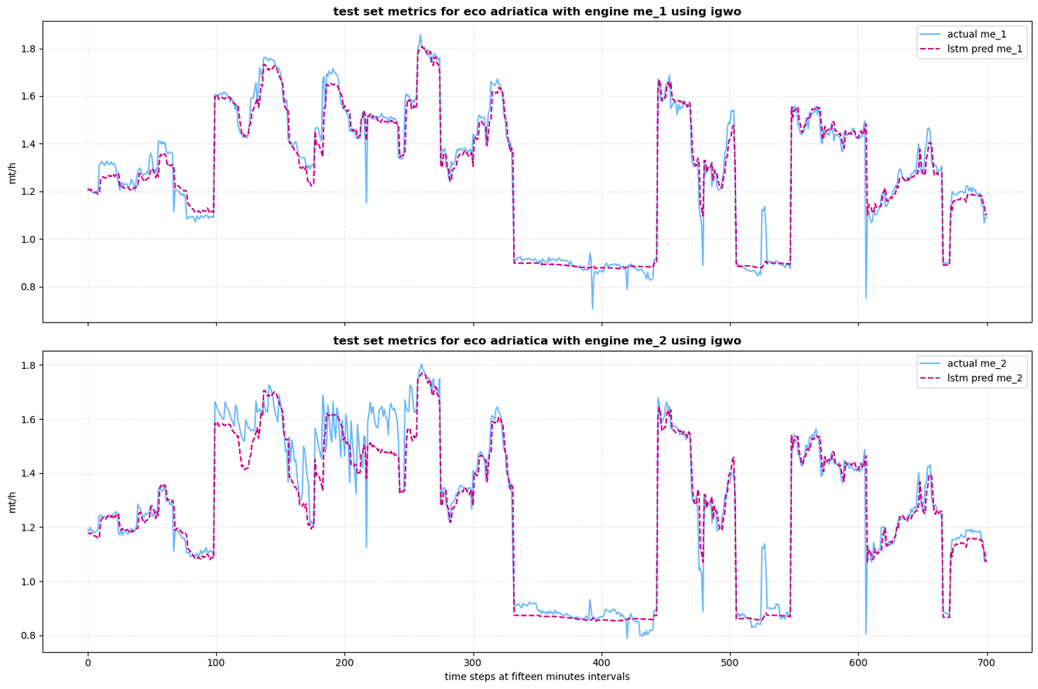
CASE STUDY
CANDIDATA
Vincenza Siani
M62003043
Results:
VESSEL 1
The Heavy Fuel Oil (HFO) consumption figures for main engine 1 and main engine 2 have been estimated for ships fitted with scrubbers
ENGINE | R2 | MAE | MAPE
ME 1 | 96% | 0,031 | 2,51%
ME 2 | 94% | 0,041 | 3,41%

Slide 22
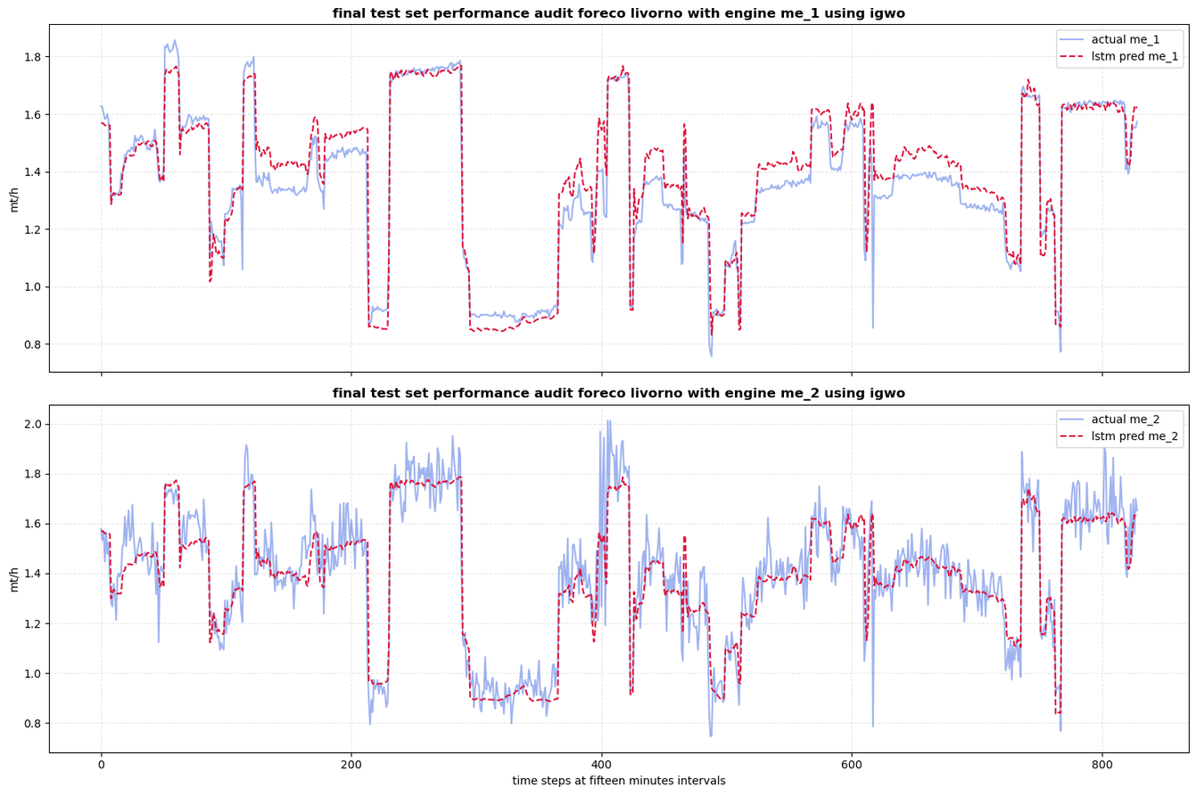
CASE STUDY
CANDIDATA
Vincenza Siani
M62003043
Results:
VESSEL 1
ENGINE | R2 | MAE | MAPE
ME 1 | 91% | 0,053 | 4,20%
ME 2 | 86% | 0,073 | 5,39%

Slide 23
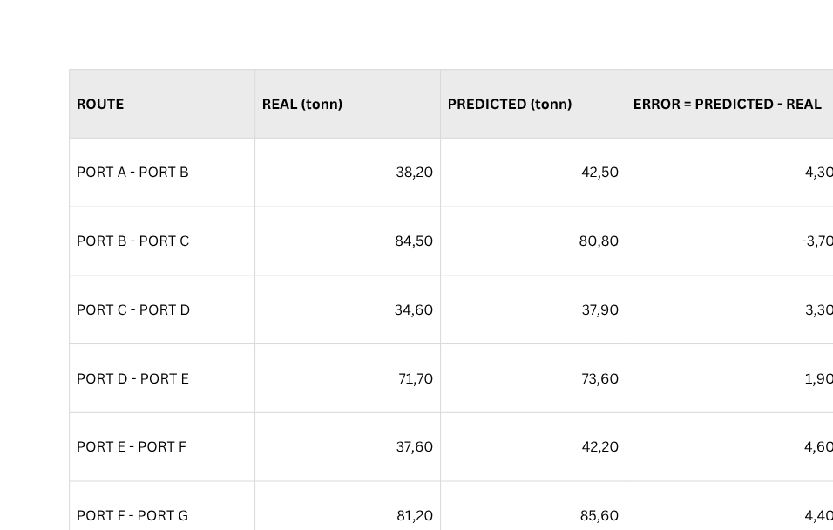
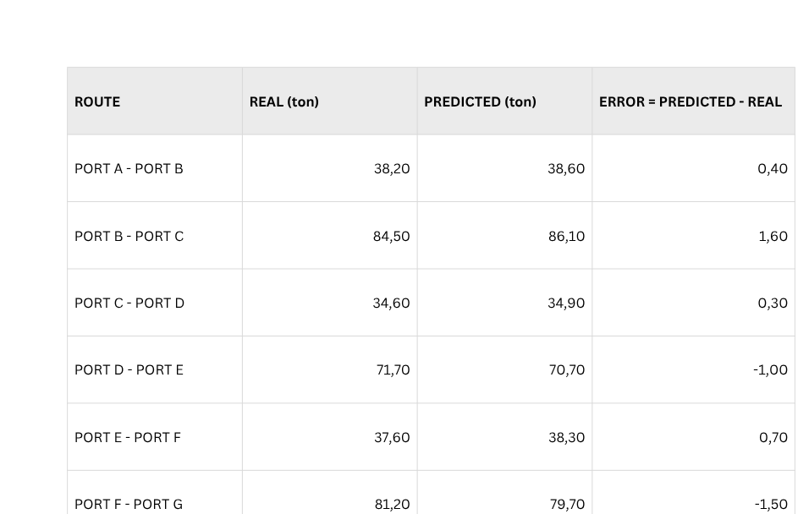
CASE STUDY
CANDIDATA
Vincenza Siani
M62003043
Results
SCHEDULE
LSTM:
LS-PLS:
TOT | 378,70 | 378,00 | -0,70
TOT | 378,70 | 395,90 | +12,70

Slide 24

CONCLUSION AND FUTURE WORK
CANDIDATA
Vincenza Siani
M62003043
DSS
OPTIMIZATION
Integration within a Business Decision Support System
Dramatically optimize your bunkering strategy
SUPERINTELLIGENT AI
Future developments may focus on the use of this instrument for multi-fuel scenarios (Methanol, Bio-LNG) and monitoring of hull degradation over time

Slide 25
CANDIDATA
Vincenza Siani
M62003043
THANK YOU FOR
YOUR ATTENTION
and Thanks to

